Slide 1
Concurrency Control

Slide 2
Lock-Based Protocols
A lock is a mechanism to control concurrent access to a data item
Data items can be locked in two modes :
1. exclusive (X) mode. Data item can be both read as well as
written. X-lock is requested using lock-X instruction.
2. shared (S) mode. Data item can only be read. S-lock is
requested using lock-S instruction.
Lock requests are made to concurrency-control manager. Transaction can proceed only after request is granted.

Slide 3


Lock-Based Protocols (Cont.)
Lock-compatibility matrix
A transaction may be granted a lock on an item if the requested lock is compatible with locks already held on the item by other transactions
Any number of transactions can hold shared locks on an item,
  but if any transaction holds an exclusive on the item no other transaction may hold any lock on the item.
If a lock cannot be granted, the requesting transaction is made to wait till all incompatible locks held by other transactions have been released. The lock is then granted.

Slide 4

Lock-Based Protocols (Cont.)
Example of a transaction performing locking:
T₂: lock-S(A);
read (A);
unlock(A);
lock-S(B);
read (B);
unlock(B);
display(A+B)
Locking as above is not sufficient to guarantee serializability — if A and B get updated in-between the read of A and B, the displayed sum would be wrong.
A locking protocol is a set of rules followed by all transactions while requesting and releasing locks. Locking protocols restrict the set of possible schedules.

Slide 5


Pitfalls of Lock-Based Protocols
Consider the partial schedule
Neither T₃ nor T₄ can make progress — executing lock-S(B) causes T₄ to wait for T₃ to release its lock on B, while executing lock-X(A) causes T₃ to wait for T₄ to release its lock on A.
Such a situation is called a deadlock.
  To handle a deadlock one of T₃ or T₄ must be rolled back
  and its locks released.

Slide 6


Pitfalls of Lock-Based Protocols (Cont.)
The potential for deadlock exists in most locking protocols. Deadlocks are a necessary evil.
Starvation is also possible if concurrency control manager is badly designed. For example:
  A transaction may be waiting for an X-lock on an item, while a sequence of other transactions request and are granted an S-lock on the same item.
  The same transaction is repeatedly rolled back due to deadlocks.
Concurrency control manager can be designed to prevent starvation.
T1(Lock-s (A)) |  |  |  | Grant
 | T2 (Lock-X (A)) |  |  | Wait
 |  | T3(Lock-s(A)) |  | Grant
 |  |  | T4(Lock-s(A)) | Grant
 |  |  | …………….

Slide 7

The Two-Phase Locking Protocol
This is a protocol which ensures conflict-serializable schedules.
Phase 1: Growing Phase
  transaction may obtain locks
  transaction may not release locks
Phase 2: Shrinking Phase
  transaction may release locks
  transaction may not obtain locks
The protocol assures serializability. It can be proved that the transactions can be serialized in the order of their lock points (i.e. the point where a transaction acquired its final lock).

Slide 8


The Two-Phase Locking Protocol (Cont.)
Two-phase locking does not ensure freedom from deadlocks
Cascading roll-back is possible under two-phase locking. To avoid this, follow a modified protocol called strict two-phase locking. Here a transaction must hold all its exclusive locks till it commits/aborts.
Rigorous two-phase locking is even stricter: here all locks are held till commit/abort. In this protocol transactions can be serialized in the order in which they commit.

Slide 9

Lock Conversions
Two-phase locking with lock conversions:
– First Phase:
  can acquire a lock-S on item
  can acquire a lock-X on item
  can convert a lock-S to a lock-X (upgrade)
– Second Phase:
  can release a lock-S
  can release a lock-X
  can convert a lock-X to a lock-S (downgrade)
This protocol assures serializability.

Slide 10
Automatic Acquisition of Locks
A transaction T_{i} issues the standard read/write instruction, without explicit locking calls.
The operation read(D) is processed as:
if T_{i} has a lock on D
then
read(D)
else begin
if necessary wait until no other
transaction has a lock-X on D
grant T_{i} a lock-S on D;
read(D)
end

Slide 11
Automatic Acquisition of Locks (Cont.)
write(D) is processed as:
if T_{i} has a lock-X on D
then
write(D)
else begin
if necessary wait until no other trans. has any lock on D,
if T_{i} has a lock-S on D
then
upgrade lock on D to lock-X
else
grant T_{i} a lock-X on D
write(D)
end;
All locks are released after commit or abort

Slide 12

Implementation of Locking
A lock manager can be implemented as a separate process to which transactions send lock and unlock requests
The lock manager replies to a lock request by sending a lock grant messages (or a message asking the transaction to roll back, in case of a deadlock)
The requesting transaction waits until its request is answered
The lock manager maintains a data-structure called a lock table to record granted locks and pending requests
The lock table is usually implemented as an in-memory hash table indexed on the name of the data item being locked

Slide 13
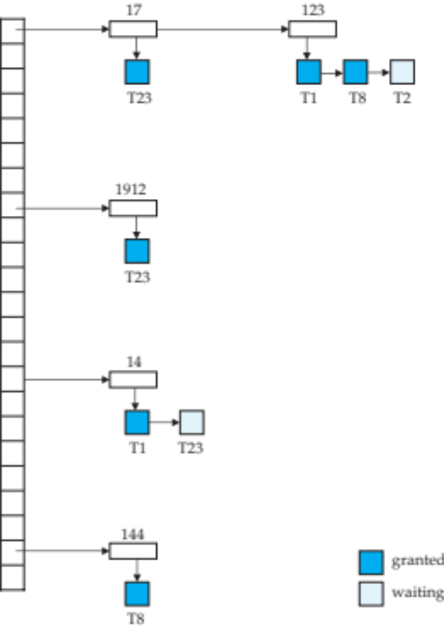

Lock Table
Black rectangles indicate granted locks, white ones indicate waiting requests
Lock table also records the type of lock granted or requested
New request is added to the end of the queue of requests for the data item, and granted if it is compatible with all earlier locks
Unlock requests result in the request being deleted, and later requests are checked to see if they can now be granted
If transaction aborts, all waiting or granted requests of the transaction are deleted
  lock manager may keep a list of locks held by each transaction, to implement this efficiently

Slide 14
Recovery and Atomicity
To ensure atomicity despite failures, we first output information describing the modifications to stable storage without modifying the database itself.
We study log-based recovery mechanisms in detail
  We first present key concepts
  And then present the actual recovery algorithm
Less used alternative: shadow-paging (brief details in book)

Slide 15

Log-Based Recovery
A log is kept on stable storage.
  The log is a sequence of log records, and maintains a record of update activities on the database.
When transaction T_{i} starts, it registers itself by writing a
<T_{i} start>log record
Before T_{i} executes write(X), a log record
<T_{i}, X, V₁, V₂>
is written, where V₁ is the value of X before the write (the old value), and V₂ is the value to be written to X (the new value).
When T_{i} finishes it last statement, the log record <T_{i} commit> is written.
Two approaches using logs
  Deferred database modification
  Immediate database modification

Slide 16

Immediate Database Modification
The immediate-modification scheme allows updates of an uncommitted transaction to be made to the buffer, or the disk itself, before the transaction commits
Update log record must be written before database item is written
  We assume that the log record is output directly to stable storage
  (Will see later that how to postpone log record output to some extent)
Output of updated blocks to stable storage can take place at any time before or after transaction commit
Order in which blocks are output can be different from the order in which they are written.
The deferred-modification scheme performs updates to buffer/disk only at the time of transaction commit
  Simplifies some aspects of recovery
  But has overhead of storing local copy

Slide 17

Transaction Commit
A transaction is said to have committed when its commit log record is output to stable storage
  all previous log records of the transaction must have been output already
Writes performed by a transaction may still be in the buffer when the transaction commits, and may be output later

Slide 18
Immediate Database Modification Example
Log Write Output
<T₀ start>
<T₀, A, 1000, 950>
<T_{o}, B, 2000, 2050
A = 950
B = 2050
<T₀ commit>
<T₁ start>
<T₁, C, 700, 600>
C = 600
B_{B} , B_{C}
<T₁ commit>
B_{A}
Note: B_{X} denotes block containing X.
B_{C} output before T₁ commits
B_{A} output after T₀ commits

Slide 19

Concurrency Control and Recovery
With concurrent transactions, all transactions share a single disk buffer and a single log
  A buffer block can have data items updated by one or more transactions
We assume that if a transaction T_{i} has modified an item, no other transaction can modify the same item until T_{i} has committed or aborted
  i.e. the updates of uncommitted transactions should not be visible to other transactions
    Otherwise how to perform undo if T1 updates A, then T2 updates A and commits, and finally T1 has to abort?
  Can be ensured by obtaining exclusive locks on updated items and holding the locks till end of transaction (strict two-phase locking)
Log records of different transactions may be interspersed in the log.

Slide 20

Undo and Redo Operations
Undo of a log record <T_{i}, X, V₁, V₂> writes the old value V₁ to X
Redo of a log record <T_{i}, X, V₁, V₂> writes the new value V₂ to X
Undo and Redo of Transactions
  undo(T_{i}) restores the value of all data items updated by T_{i} to their old values, going backwards from the last log record for T_{i}
    each time a data item X is restored to its old value V a special log record <T_{i} , X, V> is written out
    when undo of a transaction is complete, a log record
    <T_{i} abort> is written out.
  redo(T_{i}) sets the value of all data items updated by T_{i} to the new values, going forward from the first log record for T_{i}
    No logging is done in this case

Slide 21

Undo and Redo on Recovering from Failure
When recovering after failure:
  Transaction T_{i} needs to be undone if the log
    contains the record <T_{i} start>,
    but does not contain either the record <T_{i} commit> or <T_{i} abort>.
  Transaction T_{i} needs to be redone if the log
    contains the records <T_{i} start>
    and contains the record <T_{i} commit> or <T_{i} abort>
Note that If transaction T_{i} was undone earlier and the <T_{i} abort> record written to the log, and then a failure occurs, on recovery from failure T_{i} is redone
  such a redo redoes all the original actions including the steps that restored old values
    Known as repeating history
    Seems wasteful, but simplifies recovery greatly

Slide 22

Immediate DB Modification Recovery Example
Below we show the log as it appears at three instances of time.
Recovery actions in each case above are:
(a) undo (T₀): B is restored to 2000 and A to 1000, and log records
<T₀, B, 2000>, <T₀, A, 1000>, <T₀, abort> are written out
(b) redo (T₀) and undo (T₁): A and B are set to 950 and 2050 and C is restored to 700. Log records <T₁, C, 700>, <T₁, abort> are written out.
(c) redo (T₀) and redo (T₁): A and B are set to 950 and 2050
respectively. Then C is set to 600

Slide 23

Checkpoints
Redoing/undoing all transactions recorded in the log can be very slow
  processing the entire log is time-consuming if the system has run for a long time
  we might unnecessarily redo transactions which have already output their updates to the database.
Streamline recovery procedure by periodically performing checkpointing
  Output all log records currently residing in main memory onto stable storage.
  Output all modified buffer blocks to the disk.
  Write a log record < checkpoint L> onto stable storage where L is a list of all transactions active at the time of checkpoint.
  All updates are stopped while doing checkpointing

Slide 24

Checkpoints (Cont.)
During recovery we need to consider only the most recent transaction T_{i} that started before the checkpoint, and transactions that started after T_{i}.
  Scan backwards from end of log to find the most recent <checkpoint L> record
  Only transactions that are in L or started after the checkpoint need to be redone or undone
  Transactions that committed or aborted before the checkpoint already have all their updates output to stable storage.
Some earlier part of the log may be needed for undo operations
  Continue scanning backwards till a record <T_{i} start> is found for every transaction T_{i} in L.
  Parts of log prior to earliest <T_{i} start> record above are not needed for recovery, and can be erased whenever desired.

Slide 25
Example of Checkpoints
T_{c}
T_{f}
T₁ can be ignored (updates already output to disk due to checkpoint)
T₂ and T₃ redone.
T₄ undone
T₁
T₂
T₃
T₄
checkpoint
system failure

